Slide 1
ARTIFICIAL INTELLIGENCE · FINANCIAL TECHNOLOGY
AI-Powered Stock Screening
and Analysis
An intelligent, unified decision-support system combining fundamental, technical
and sentiment analysis — optimized with the Steepest-Ascent Hill Climbing algorithm.
PRESENTED BY
ALGORITHM
Steepest-Ascent
Hill Climbing
Danyl Enoch
240701092
Mohideen Abdul Kader M L
240701329
Academic Year 2026–2027

Slide 2
Abstract
Investors today must evaluate large volumes of stocks before making sound investment decisions, but traditional analysis demands in-depth manual study of financial statements, historical prices, market trends, and technical indicators. This kind of manual evaluation, spread across fragmented tools and data sources, is time-consuming and complex — particularly for beginners.
This project proposes an intelligent, unified system that leverages artificial intelligence and data-driven techniques to screen and analyze equities efficiently. Rather than relying on scattered, single-purpose tools, the system integrates fundamental analysis, technical analysis, and news sentiment analysis (NLP) into a single interface, computing automated scores, rankings, and plain-language explanations for each stock.
At the core of the analytical engine is the Steepest-Ascent Hill Climbing algorithm, a local-search optimization technique that iteratively moves toward the neighboring state offering the steepest improvement in score — allowing the system to converge efficiently on strong-performing stock rankings. The result is a scalable, explainable decision-support tool intended to reduce manual screening effort and make multi-factor analysis accessible to investors of all experience levels — offering insight, not guaranteed returns.

Slide 3






Literature Survey
Prior approaches to stock screening and analysis
1. Stock Screening Systems
2. Technical Analysis
3. Machine Learning in Stock Analysis
Traditional screeners filter assets using rule-based metrics such as Market Capitalization, P/E, P/B, revenue growth, and dividend yield to narrow down candidates.
Examines price action and volume trends using indicators like Moving Averages, RSI, and MACD to evaluate historical patterns.
Predictive and classification models (Linear Regression, Decision Trees, Random Forest) identify underlying non-linear patterns in financial data.
4. Sentiment Analysis (NLP)
5. Steepest-Ascent Hill Climbing
AI-Based Decision Support & Research Gap
Analyzes financial news, corporate reports, and media text to classify sentiment as positive, neutral, or negative.
A local-search optimization technique that iteratively moves to the neighboring state with the steepest score improvement — used here to optimize stock-scoring weights toward the best-ranked candidates.
Gap: existing platforms rely on manual filters across disconnected tools without explainable AI. Solution: a unified platform integrating screening, technicals, fundamentals, and AI-driven explanations.

Slide 4
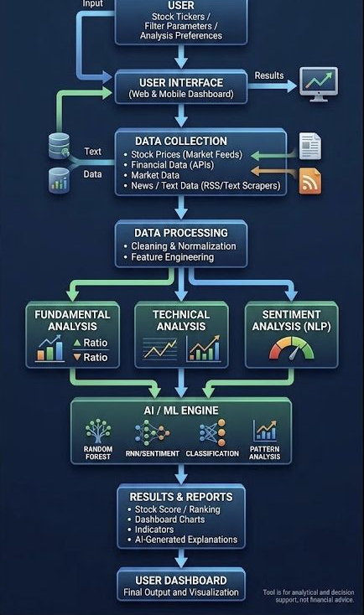
System Architecture
Seven-layer pipeline: from user input to AI-generated insight
1
User Layer
Input of stock tickers, screening preferences, and custom filter criteria.
2
User Interface Layer
Responsive web / mobile dashboard for interaction and visualization.
3
Data Collection Layer
Aggregation of market prices, financial statements, trading volume, and news text.
4
Data Processing Layer
Data cleaning, normalization, and feature engineering.
5
Multi-Branch Analysis
Fundamental · Technical · Sentiment (NLP) analysis modules run in parallel.
6
AI / ML Engine
Feature combination, pattern analysis, and stock scoring / ranking generation.
7
Results & Reports Layer
Final stock scores, comparative charts, indicators, and AI-generated explanations.

Slide 5

Modules
The four functional modules that make up the analysis engine
Fundamental Analysis Module
Technical Analysis Module
Evaluates financial ratios, earnings, and balance-sheet metrics to gauge a company's underlying financial health.
Tracks moving averages, RSI, MACD, and price/volume dynamics to evaluate historical trading patterns.
Sentiment Analysis Module
AI / ML Engine Module
Applies NLP to financial news, corporate reports, and media text, classifying sentiment as positive, neutral, or negative.
Combines features from all three branches — using Random Forest, RNN/sentiment models, classification, and pattern analysis, optimized via Steepest-Ascent Hill Climbing — to generate stock scores and rankings.

Slide 6


Output
What the user ultimately receives from the system
Results & Reports
User Dashboard
Stock Score / Ranking
The final output layer consolidates every module's results into one visualization: a responsive web and mobile dashboard where the investor can browse ranked stocks, drill into individual scores, and read the AI-generated reasoning behind each ranking — all in one place.
A composite, weighted score for each stock, ranked for easy comparison.
Dashboard Charts
Visual comparisons of price trends, indicators, and multi-factor scores.
Indicators
Key technical and fundamental indicators surfaced alongside each result.
PURPOSE
Analytical and decision support — not financial advice.
AI-Generated Explanations
Plain-language summaries explaining why a stock received its score.

Slide 7
Thank You
AI-Powered Stock Screening and Analysis — Questions & Discussion
Danyl Enoch
240701092
Mohideen Abdul Kader M L
240701329
This tool is for analytical and decision support — not financial advice.

